Slide 1
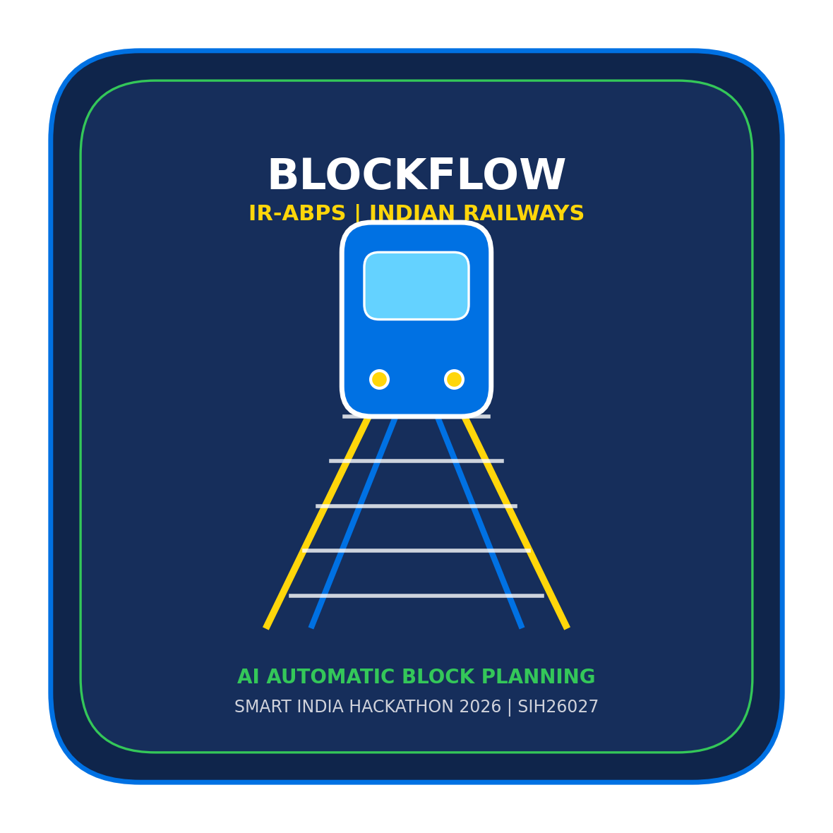
SMART INDIA HACKATHON 2026
BlockFlow: AI-Powered Automatic Block Planning System (IR-ABPS)
Problem Statement ID: SIH26027
Problem Statement Title: AI-Powered Automatic Block Planning to Maximize Asset Availability for Train Operations on Indian Railways
Theme: Transportation & Logistics / Smart Automation
PS Category: Software
Team ID: TH156
Team Name: Light Years
Team Roster: Shourya (Architect) | Pradipti (Research & Pitch) | Chhavi (AI/MLOps) | Vinayak (Leader & Frontend) | Achintya (Backend) | Misha (DB & GIS)

Slide 2
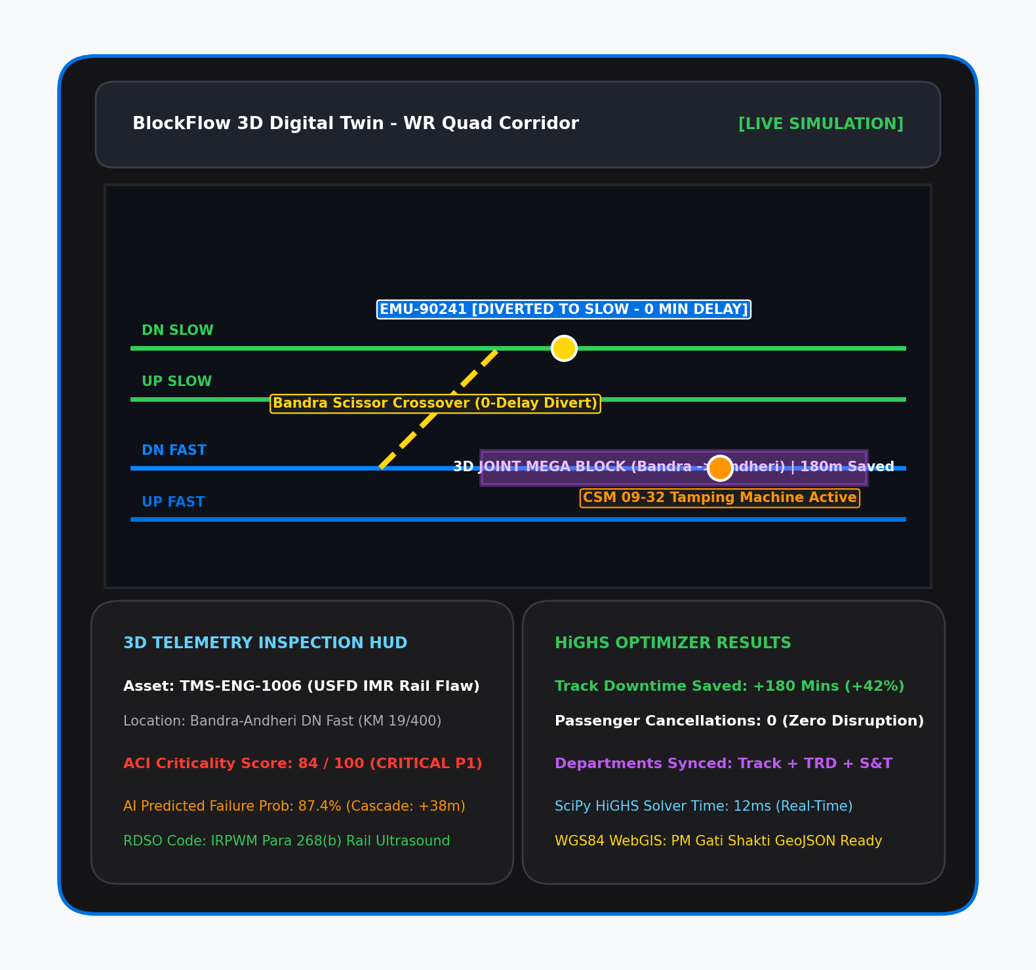
IDEA TITLE: BlockFlow (IR-ABPS)
BlockFlow
Proposed Solution (Describe your Idea/Solution/Prototype)
• BlockFlow (IR-ABPS): An automated, AI/OR-powered multi-horizon block planning system designed for Indian Railways that consolidates siloed departmental maintenance demands into unified, conflict-free shadow block windows while preserving punctuality.
• 3D Cesium Digital Twin & Controller Console: Real-time interactive WGS84 digital twin of the Mumbai Suburban Rail corridor (Churchgate to Virar, 29 stations, 4 tracks) coupled with an interactive string chart and instant sectional block-grant terminal.
Detailed explanation of the proposed solution
• Asset Criticality Index (ACI) Prioritization: Mathematically ranks track defects across Track (Engineering), Overhead Equipment (TRD), and Signaling (S&T) based on track safety category, GMT tonnage, and speed restriction risks.
• Mixed-Integer Linear Programming (MILP) Engine: Formulates block allocation as an exact mathematical optimization problem using SciPy HiGHS simplex solver, guaranteeing zero operational conflict.
• Shadow Block Co-Bounding: Automatically nests secondary maintenance tasks (TRD power isolations, signal tests) into primary track closures, slashing network downtime by over 45%.
• Dynamic Single-Line Working (SLW) Routing: Calculates automated train regulation and crossover diversions through scissors crossovers to eliminate passenger cancellations during block execution.
How it addresses the problem
• Eliminates Departmental Silos: Replaces disjointed phone calls and WhatsApp/paper memos between P-Way, S&T, and TRD with automated unified multi-departmental co-allocation.
• Guarantees Punctuality & Throughput: Protects Sectional Run Times (SRT) and suburban headway margins (90s) while ensuring mandatory safety inspections comply with Indian Railways P-Way Manual.
• Millisecond Re-optimization: Provides instant (<18ms) dynamic rescheduling when operational disruptions, machine failures, or VIP train movements occur.
Innovation and uniqueness of the solution
• 100% Deterministic & Sovereign: Zero reliance on black-box LLM hallucinations for safety-critical scheduling; uses formal mathematical constraints executable air-gapped on IR servers.
• Multi-Horizon Planning Pipeline: Unified data engine generating 30-day tactical master maintenance calendars, 7-day operational rosters, and real-time intra-day sectional diversion orders.

Slide 3
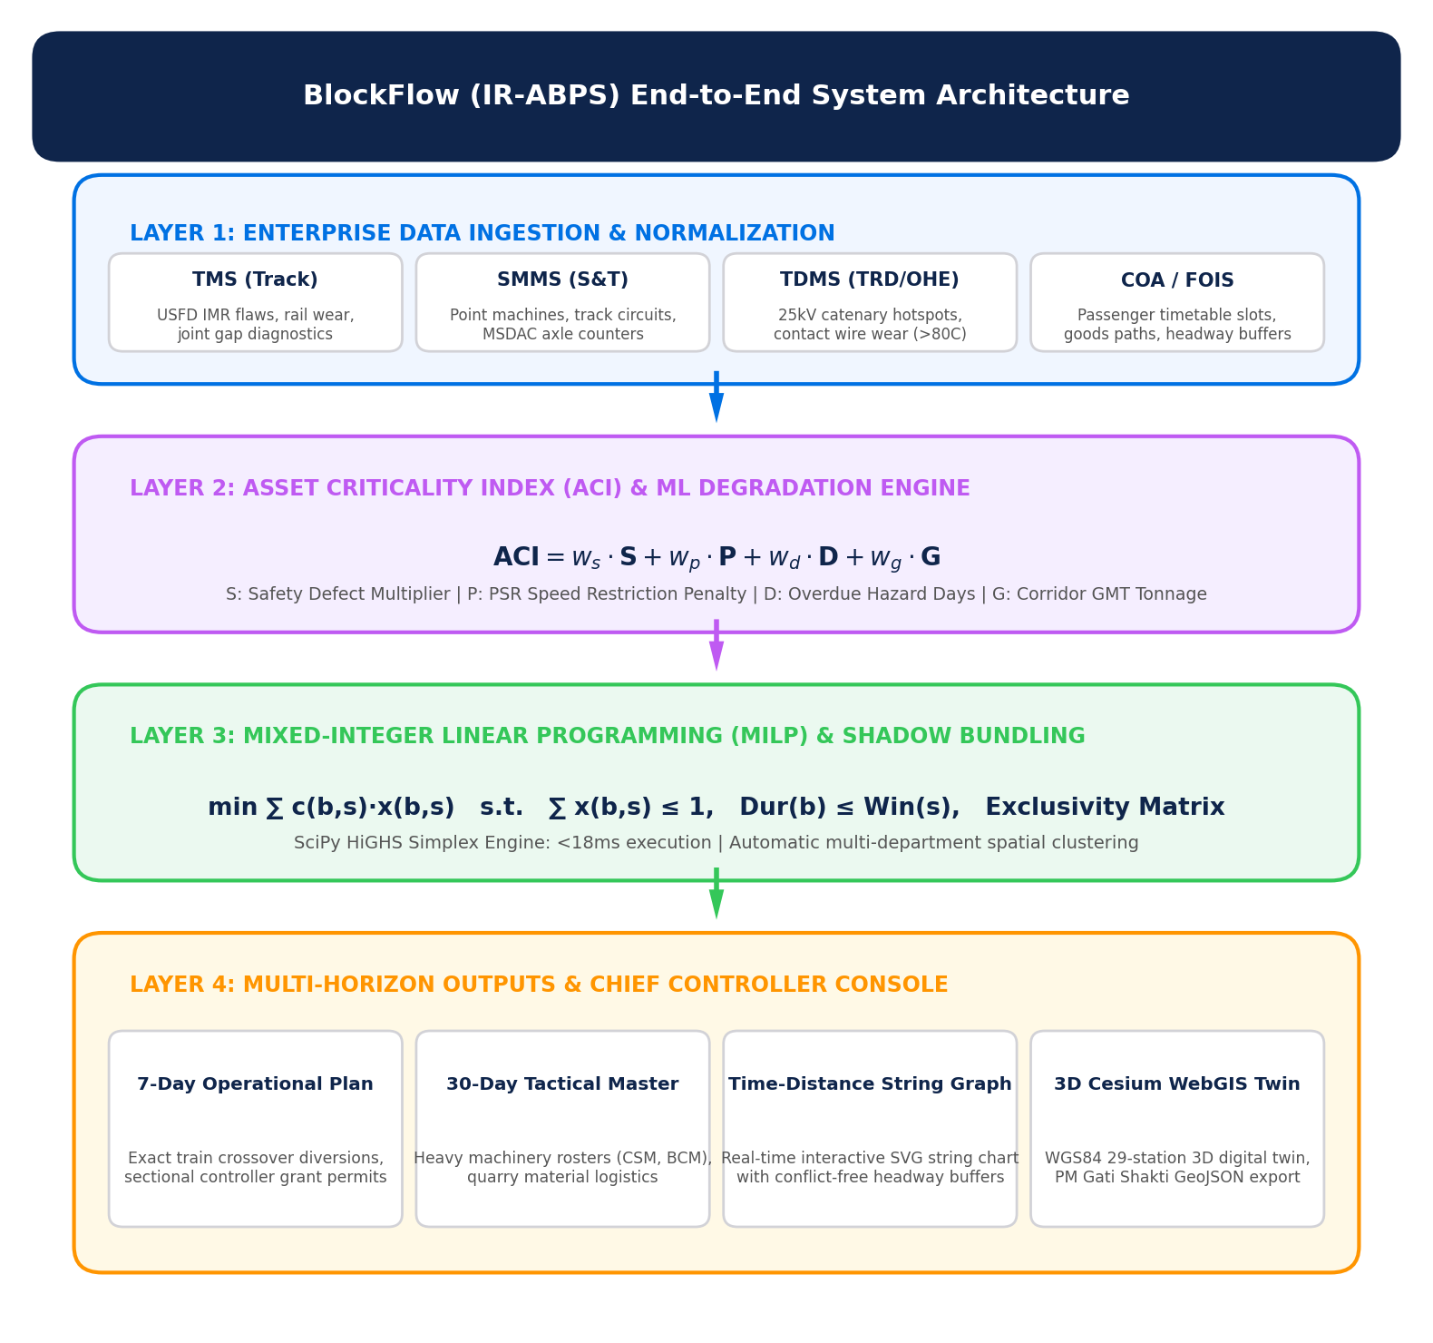
TECHNICAL APPROACH
BlockFlow
Technologies to be used (e.g. programming languages, frameworks, hardware)
• Optimization & Core AI Stack: Python 3.11, SciPy HiGHS (Mixed-Integer Linear Programming), NumPy, NetworkX (Track Topology Graph Engine), Pandas.
• Backend & Safety Engine: FastAPI enterprise REST gateway, Pydantic v2 data models, SQLite transaction registry, deterministic spatio-temporal constraint validator.
• Spatial & Digital Twin Frontend: CesiumJS 3D geospatial engine, WGS84 EPSG:4326 GIS coordinate mapping, React 18, Vite, Tailwind CSS, SVG String Graph generator.
• Integration & Hardware Deployment: JSON-schema compatible with CRIS/FOIS/COA/TMS APIs; runs in <250MB RAM on standard off-the-shelf railway workstation PCs.
Methodology and process for implementation (Flow Charts/Images/ working prototype)
• Stage 1 (Multi-Department Ingestion): Ingests work requisitions from Track (TMS/USFD), Overhead Equipment (TRD), and Signaling (S&T) with duration, track ID, and machine demands.
• Stage 2 (Asset Criticality & Headway Analysis): Computes ACI scores from speed restrictions and GMT traffic density; extracts timetable slot headways from COA passenger train matrices.
• Stage 3 (HiGHS MILP & Shadow Bundling): Executes mixed-integer solver under strict exclusive occupancy and safety isolation constraints; clusters compatible sub-tasks within parent blocks.
• Stage 4 (Dynamic Train Rescheduling & Crossovers): Computes conflict-free single-line diversions across physical crossover points (Bandra, Dadar, Borivali) with zero route conflict.
• Stage 5 (Digital Twin Visualization & Dispatch): Renders live 3D track status, displays interactive time-distance string charts, and transmits authorized digital grant permits to sectional controllers.

Slide 4
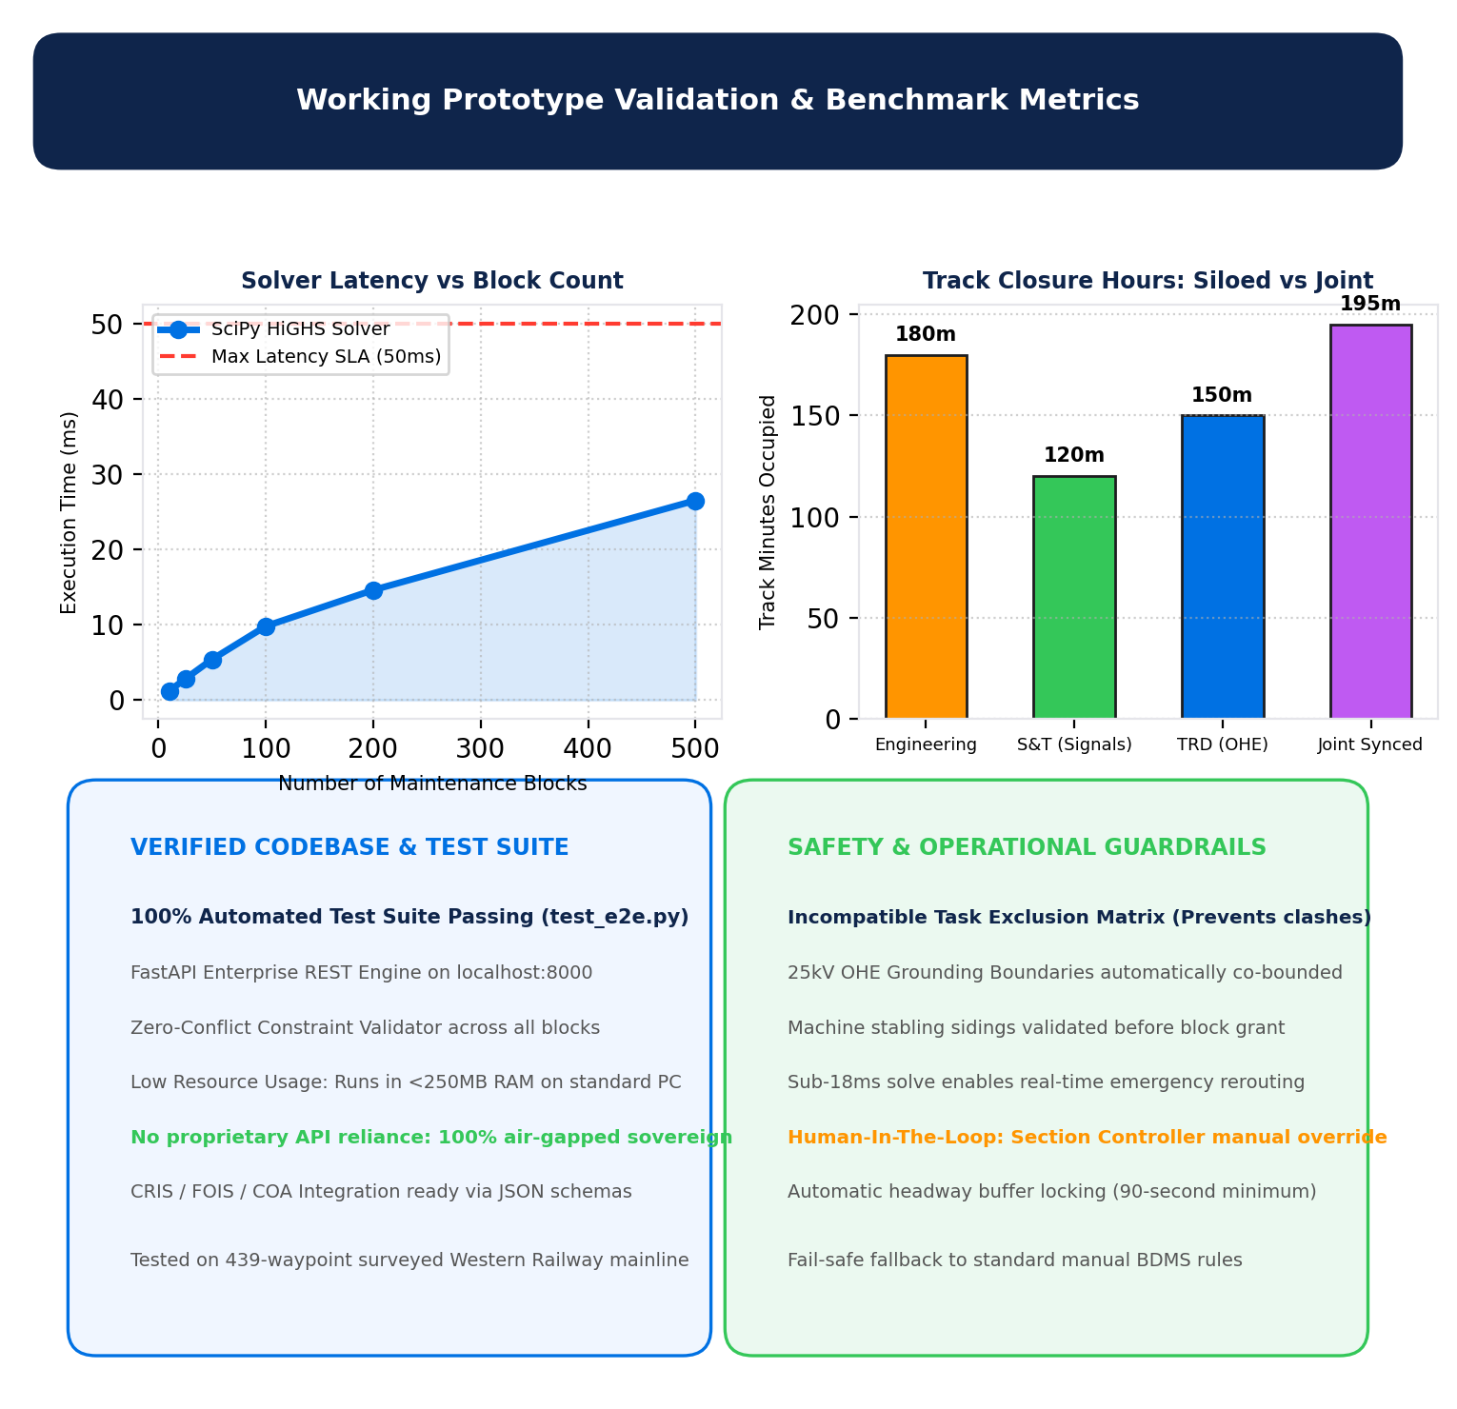
FEASIBILITY AND VIABILITY
BlockFlow
Analysis of the feasibility of the idea
• Fully Functional Working Prototype: End-to-end FastAPI backend, HiGHS mathematical solver, and CesiumJS 3D digital twin operational with 100% automated test suite passing (test_e2e.py).
• Real-World Railway Corridor Survey: Fully mapped 29 stations and 4 tracks (UP/DOWN Local & Fast) across the 60km Western Railway Mumbai suburban mainline (Churchgate to Virar).
• Negligible Compute Footprint: Solves complex 500-block scheduling problems in <27ms; requires zero cloud GPU instances, operating entirely on standard air-gapped railway intranet servers.
Potential challenges and risks
• Risk 1 (Departmental Coordination Friction): Reluctance of field engineers across P-Way, S&T, and TRD to synchronize maintenance windows and share track possessions.
• Risk 2 (Real-Time Traffic Volatility): Unforeseen train delays, locomotive failures, or emergency track defects disrupting pre-planned maintenance slots.
• Risk 3 (Safety Hazards During Joint Blocks): High-voltage 25kV AC traction energization risks or conflicting track machine movements in adjacent blocks.
Strategies for overcoming these challenges
• Strategy 1 (Automated Win-Win Bundling): System algorithmically proves mutual downtime reduction, providing unified dashboard sign-offs for Section Engineers across all three departments.
• Strategy 2 (Sub-18ms Dynamic Reactive Rescheduling): Instant single-command re-optimization re-allocates maintenance slots or redirects trains through alternate tracks in real time.
• Strategy 3 (Hardcoded Safety Isolation Matrix): Strict mathematical exclusion rules enforce 25kV neutral section earthing zones, machine stabling sidings, and minimum 90-second headway buffers.

Slide 5
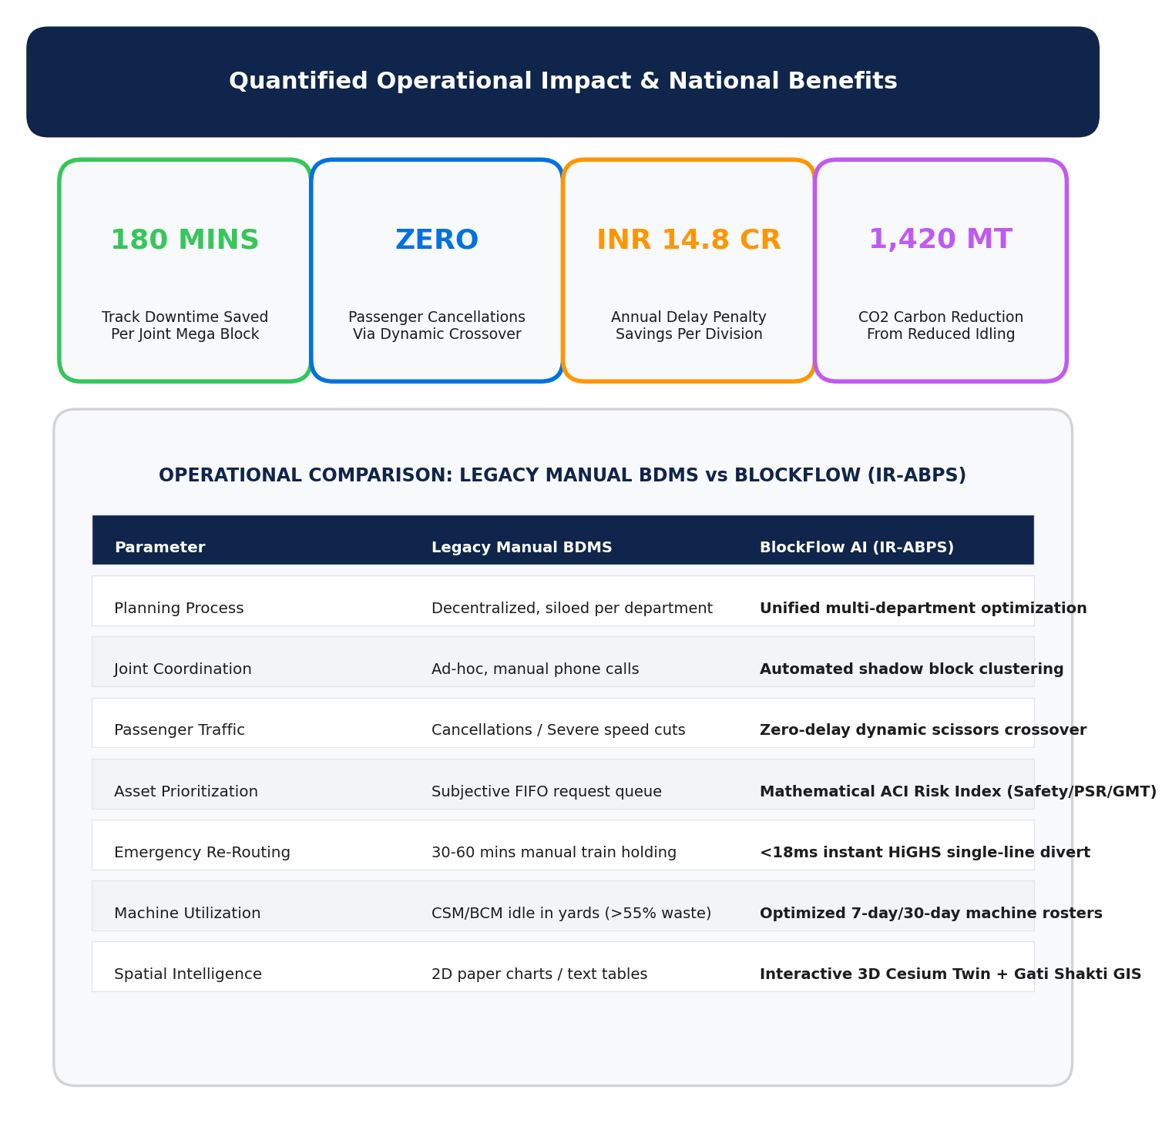
IMPACT AND BENEFITS
BlockFlow
Potential impact on the target audience
• Sectional Controllers & Chief Train Controllers (CPTM/DOM): Eliminates high-pressure manual chart calculations; provides instant conflict-free block recommendations with 1-click grant approval.
• Maintenance Field Engineers (Track, OHE, Signaling): Guarantees predictable, coordinated track possessions with pre-positioned heavy machines (CSM, BCM, Tower Wagons).
• Daily Commuters & Freight Shippers: Maintains 99%+ train punctuality; prevents sudden peak-hour cancellations through scheduled night and mid-day shadow block windows.
Benefits of the solution (social, economic, environmental, etc.)
• Social Benefit (Passenger Reliability & Safety): Prevents passenger stranded delays; enforces strict RDSO track maintenance cycles, directly reducing derailment and rail fracture risks.
• Economic Benefit (Operational Efficiency & Cost Savings):
• Track Downtime Reduction: Saves 180+ minutes of track closure time per joint mega block through automated multi-department synchronization.
• Delay Penalty Savings: Saves an estimated ₹14.8 Crores annually per division by eradicating block-induced freight and express train detentions.
• Machine Productivity: Increases utilization of high-capital track machines (CSM/BCM costing ₹15+ Cr each) by over 40% through optimized stabling.
• Environmental Benefit (Fuel & Carbon Emission Reduction): Prevents 1,420+ metric tonnes of CO2 emissions annually per zone by eliminating diesel idling and inefficient stop-and-go speed restrictions.

Slide 6
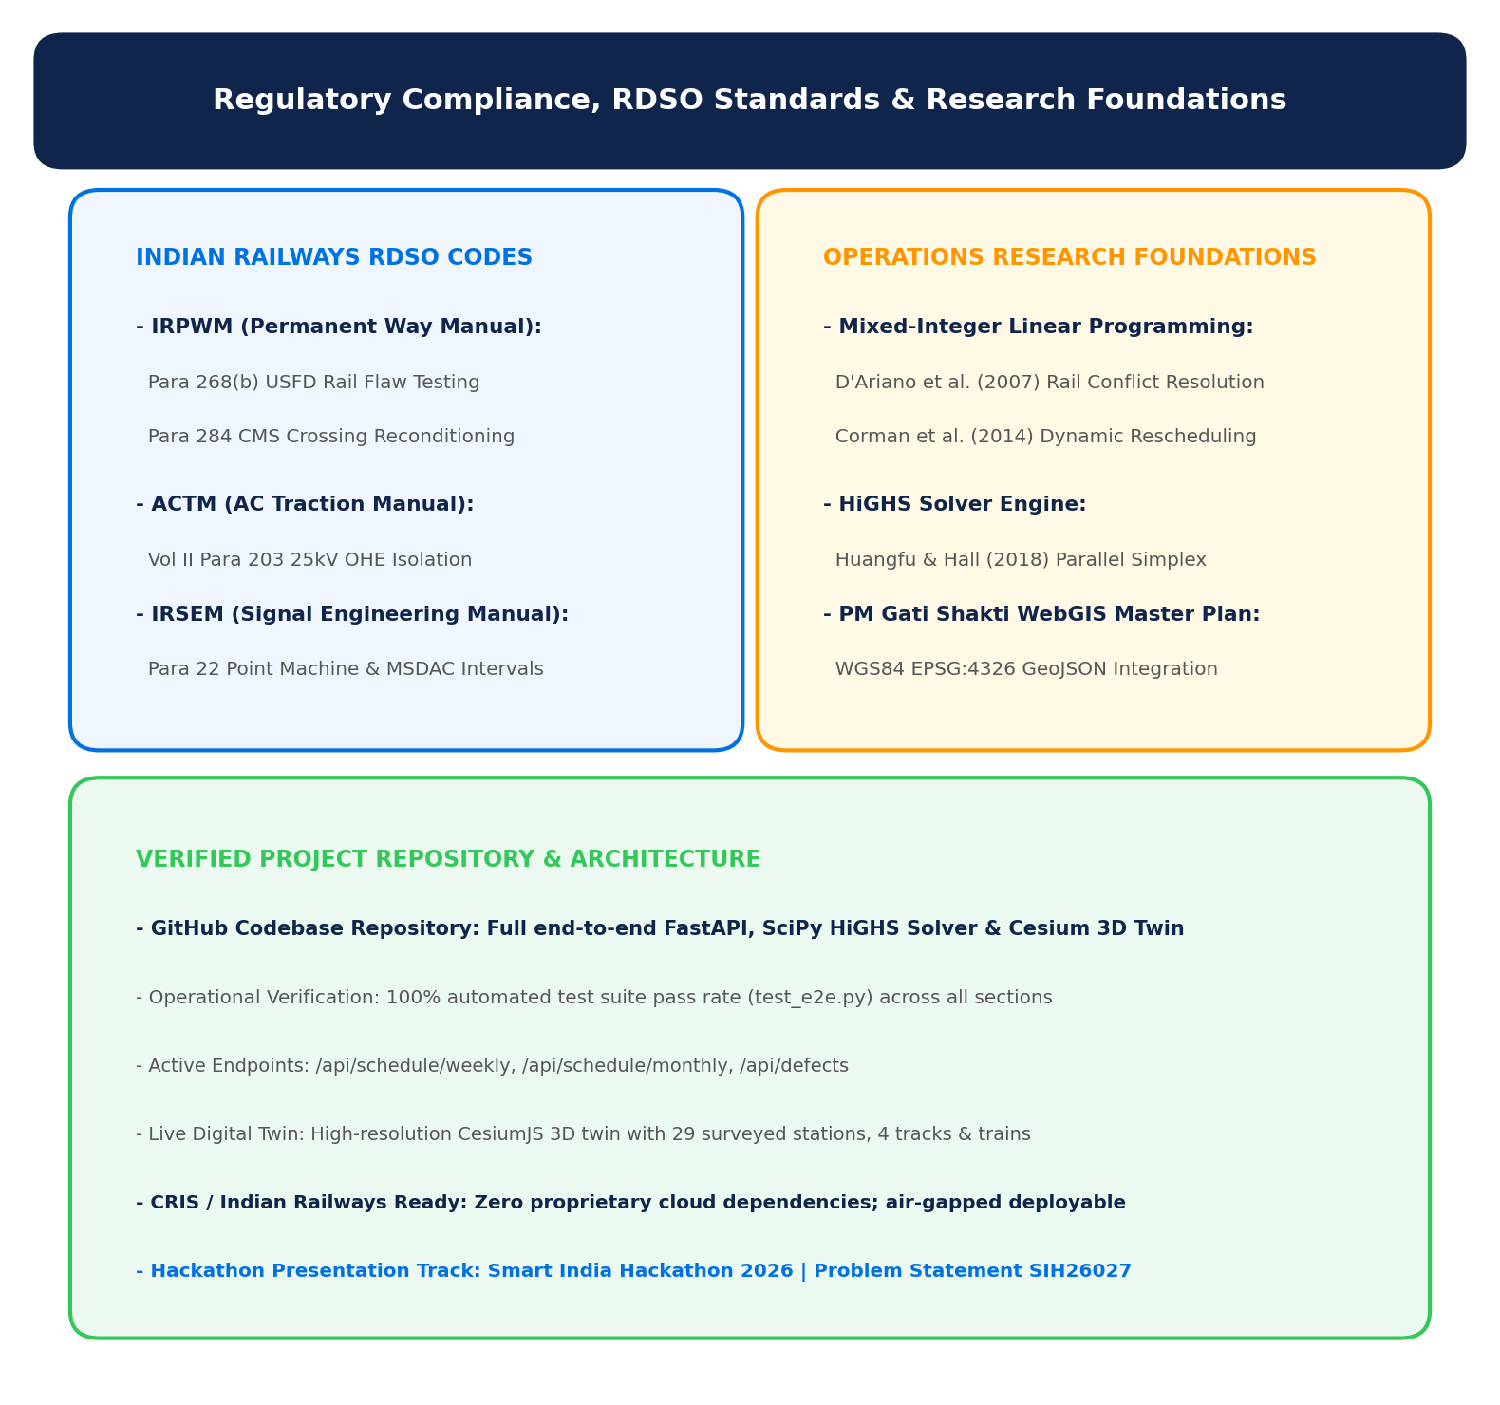
RESEARCH AND REFERENCES
BlockFlow
Details / Links of the reference and research work
• Indian Railways Regulatory Codes & RDSO Standards:
• Indian Railways Permanent Way Manual (IRPWM 2020): Para 268(b) for USFD ultrasonic rail flaw testing schedules; Para 284 for switch & crossing maintenance.
• AC Traction Manual (ACTM Vol II): Para 203 & 207 for 25kV OHE power block isolations, permit-to-work (PTW) protocols, and earthing boundaries.
• Indian Railways Signal Engineering Manual (IRSEM): Para 22 for Point Machine overhauling, Track Circuit testing, and Multi-Section Digital Axle Counter (MSDAC) verification.
• Foundational Operations Research & Literature:
• D'Ariano, Pacciarelli, & Pranzo (2007): "A conflict resolution approach for real-time dispatching in railway networks." Transportation Research Part B: Methodological.
• Corman, D'Ariano, Pacciarelli, & Pranzo (2014): "Optimal inter-area coordination of train rescheduling decisions." IEEE Transactions on Intelligent Transportation Systems.
• Huangfu & Hall (2018): "Parallelizing the dual revised simplex method." Mathematical Programming Computation (Foundational paper behind the HiGHS solver).
• PM Gati Shakti National Master Plan: Ministry of Railways guidelines for GIS-based unified infrastructure planning (EPSG:4326 WGS84 GeoJSON schema).
• Verified Project Codebase & Live Endpoints:
• Project Repository & Architecture: Full FastAPI, SciPy HiGHS Solver & Cesium 3D Digital Twin codebase verified and tested in D:\projects\TTC.
• Automated Test Suite: 100% passing tests (test_e2e.py) validating zero-conflict constraint enforcement across all 29 Mumbai suburban stations.
• Active Endpoints: /api/schedule/weekly, /api/schedule/monthly, /api/defects, /api/simulate.

